Slide 1
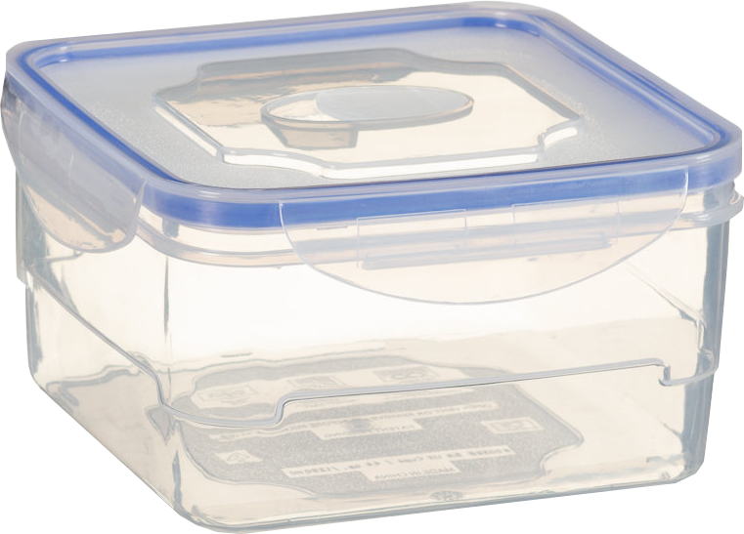

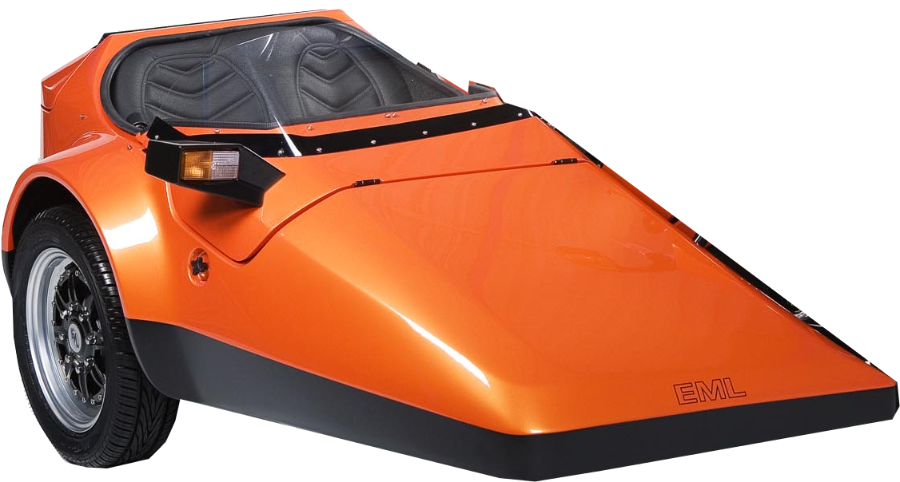
Distributed cloud contribution demo – link view
AWS
Amsterdam
G6 server
Demo MFEL (aka ‘MFCP transcode’) and MFCP containers are run one at a time – both containers should not be running at the same time.
T2 Micro
Choreographer
AWS VPN
Prometheus
Grafana
K8s
UDP-Monitor
(muhook)
Logstash
Kibana
720p50 SDI
MFCP
T2 Micro
T2 Micro
UDP-Monitor
(muhook)
K8 Master
Multicast
AWS VPN
Streamer
MFEL
HD (720p50) SDI
CE-X card
Multicast
AVP 2000
720p50 SDI from AVP 2000
Or from MFEL
4K SDI
MUCONV
Multicast
MFCP 2
CE-HEVC
AVP 2000 output also used for optimized latency OTT demo (DTC)
SMPTE 2110
(720p50)
Tek Prism
GTP master, etc
Server
MFCP 3
IBC
Appliance
MFCP 4
4K SDI
Application
Korysys
Confidence Monitor

Slide 2
Distributed cloud contribution demo – IP address view
AWS
Amsterdam
K8 Master
Demo MFEL (aka ‘MFCP transcode’) and MFCP containers are run one at a time – both containers should not be running at the same time.
T2 Micro
G6 server
Choreographer
AWS VPN
Prometheus
Grafana
K8s
UDP-Monitor
(muhook)
Logstash
Kibana
720p50 SDI
MFCP
T2 Micro
T2 Micro
K8s Master
UDP-Monitor
(muhook)
AWS VPN
Streamer
Multicast
MFEL
HD (720p50) SDI
CE-X card
Multicast
AVP 2000
720p50 SDI from AVP 2000
Or from MFEL
4K SDI
MUCONV
Multicast
MFCP 2
CE-HEVC
AVP 2000 output also used for optimized latency OTT demo (DTC)
SMPTE 2110
(720p50)
Tek Prism
GTP master, etc
Server
MFCP 3
IBC
Appliance
MFCP 4
4K SDI
Application
Korysys
Confidence Monitor

